Slide 1
CS212-Object Oriented Programming
Lecture 12
Exception Handling in Java
Read with Chapter 12 of Course Book

Slide 2
Exception Handling in Java
The exception handling in java is one of the powerful mechanism to handle the runtime errors so that normal flow of the application can be maintained
What is exception?
Dictionary Meaning: Exception is an abnormal condition.
In java, exception is an event that disrupts the normal flow of the program. It is an object which is thrown at runtime.
What is exception handling?
Exception Handling is a mechanism to handle runtime errors such as ClassNotFound, IO, SQL, Remote etc.

Slide 3
What is an Exception?
Exceptional event
Error that occurs during runtime
Cause normal program flow to be disrupted
Examples
Divide by zero errors
Accessing the elements of an array beyond its range
Hard disk crash
Opening a non-existent file
Heap memory exhausted
A user has entered invalid data.
A file that needs to be opened cannot be found.
A network connection has been lost in the middle of communications or the JVM has run out of memory.

Slide 4
Exceptions
An exception in Java is an object that is created when an abnormal situation arises in your program
This object has members that stores information about the nature of the problem
An Exception is always an object of some subclass of the standard class Throwable
Java provides a very well defined hierarchy of Exceptions to deal with situations which are unusual.
All standard exceptions are covered by two direct subclasses of the class Throwable
Class Error
Class Exception

Slide 5
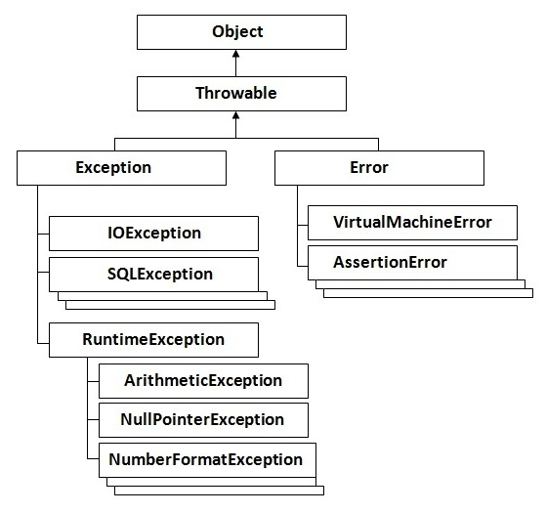

Slide 6
The Error and Exception Classes
Error class
Used by the Java run-time system to handle errors occurring in the run-time environment
Generally beyond the control of user programs
Examples
Out of memory errors
Hard disk crash
Exception class
Conditions that user programs can reasonably deal with
Usually the result of some flaws in the user program code
Examples
Division by zero error
Array out-of-bounds error

Slide 7
Types of Exception
There are mainly two types of exceptions: checked and unchecked where error is considered as unchecked exception. The sun microsystem says there are three types of exceptions:
Checked Exception
Unchecked Exception
Error
Checked Exception
The classes that extend Throwable class except RuntimeException and Error are known as checked exceptions e.g.IOException, SQLException etc. Checked exceptions are checked at compile-time.
Unchecked Exception
The classes that extend RuntimeException are known as unchecked exceptions e.g. ArithmeticException, NullPointerException, ArrayIndexOutOfBoundsException etc. Unchecked exceptions are not checked at compile-time rather they are checked at runtime.
Error
Error is irrecoverable e.g. OutOfMemoryError, VirtualMachineError, AssertionError etc.

Slide 8
Checked Exceptions
A checked exception is an exception that is typically a user error or a problem that cannot be foreseen by the programmer.
For example, if a file is to be opened, but the file cannot be found, an exception occurs.
These exceptions cannot simply be ignored at the time of compilation.
It means if a method is throwing a checked exception then it should handle the exception using try-catch block or it should declare the exception using throws keyword, otherwise the program will give a compilation error.
Here are the few other checked exceptions
SQLException
IOException
DataAccessException
ClassNotFoundException
InvocationTargetException

Slide 9
Unchecked Exceptions
In most cases, unchecked exceptions reflect programming logic errors that are not recoverable.
For example,
A NullPointerException is thrown if you access an object through a reference variable before an object is assigned to it;
An IndexOutOfBoundsException is thrown if you access an element in an array outside the bounds of the array.
These are the logic errors that should be corrected in the program.
Unchecked exceptions can occur anywhere in the program.
To avoid cumbersome overuse of try-catch blocks, Java does not mandate you to write code to catch unchecked exceptions.
Note: All Unchecked exceptions are direct sub classes of RuntimeException class.

Slide 10
Common Exception Scenarios
Scenario where ArithmeticException occurs
If we divide any number by zero, there occurs an ArithmeticException.
int a = 50 / 0; // ArithmeticException
Scenario where NullPointerException occurs
If we have null value in any variable, performing any operation by the variable occurs an NullPointerException.
String s = null;
// NullPointerException
System.out.println(s.length());

Slide 11
Common Exception Scenarios
Scenario where NumberFormatException occurs
The wrong formatting of any value, may occur NumberFormatException. Suppose I have a string variable that have characters, converting this variable into digit will occur NumberFormatException.
String s = "abc";
int i = Integer.parseInt(s);//NumberFormatException
Scenario where ArrayIndexOutOfBoundsException occurs
If you are inserting any value in the wrong index, it would result ArrayIndexOutOfBoundsException as shown below.
int[] a[] = new int[5];
a[10] = 50; // ArrayIndexOutOfBoundsException

Slide 12
Exception Handling Keywords
There are 5 keywords used in java exception handling:
try
catch
finally
throw
throws

Slide 13
The try-catch Statements
Syntax:
try {
<code to be monitored for exceptions>
} catch (<ExceptionType1> <ObjName>) {
<handler if ExceptionType1 occurs>…
} catch (<ExceptionTypeN> <ObjName>) {
<handler if ExceptionTypeN occurs>…
}

Slide 14
Example-1
class DivByZero {
public static void main(String[] args) {
try {
System.out.println(3 / 0);
System.out.println("Please print me.");
} catch (ArithmeticException exc) {
// Division by zero is an
// ArithmeticException
System.out.println(exc);
}
System.out.println("After exception.");
}
}

Slide 15
Example 2
public class TestMultipleCatchBlock {
public static void main(String[] args) {
try {
int a[] = new int[5];
a[5] = 30 / 0;
} catch(ArithmeticException e) {
System.out.println("Arithmetic Exception" + e);
} catch(ArrayIndexOutOfBoundsException e) {
System.out.println(e.getMessage());
} catch(Exception e) {
System.out.println(e.getMessage());
}
System.out.println("rest of the code...");
}
}
Rule: All catch blocks must be ordered from most specific to most general i.e. catch for ArithmeticException must come before catch for Exception.

Slide 16
Nested Try
class NestedTryDemo {
public static void main(String[] args){
try {
int a = Integer.parseInt(args[0]);
try {
int b = Integer.parseInt(args[1]);
System.out.println(a/b);
} catch (ArithmeticException e) {
System.out.println("Div by zero error!");
}
}
catch (ArrayIndexOutOfBoundsException e) {
System.out.println("Need 2 parameters!");
}
}
}

Slide 17
Nested Try With Methods
class NestedTryDemo2 {
static void nestedTry(String[] args) {
try {
int a = Integer.parseInt(args[0]);
int b = Integer.parseInt(args[1]);
System.out.println(a/b);
} catch (ArithmeticException e) {
System.out.println("Div by zero error!");
}
}
public static void main(String[] args) {
try {
nestedTry(args);
} catch (ArrayIndexOutOfBoundsException e) {
System.out.println("Need 2 parameters!");
}
}
}

Slide 18
Finally Block
Java finally block is a block that is used to execute important code such as closing connection, stream etc.
Java finally block is always executed whether exception is handled or not.
Why use java finally?
Finally block in java can be used to put "cleanup" code such as closing a file, closing connection etc.
For each try block there can be zero or more catch blocks, but only one finally block.
The finally block will not be executed if program exits(either by calling System.exit() or by causing a fatal error that causes the process to abort).
Note: If you don't handle exception, before terminating the program, JVM executes finally block (if any).

Slide 19
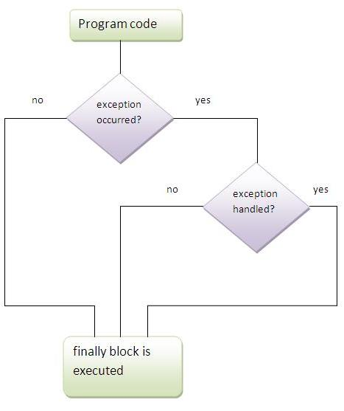

Slide 20
Finally Block
try {
<code to be monitored for exceptions>
}
catch (<ExceptionType1> <ObjName>) {
<handler if ExceptionType1 occurs>
}
finally {
<code to be executed before the try block ends>
}

Slide 21
Usage of Finally Let's see the different cases where java finally block can be used.
CASE -1
Example where exception doesn't occur.
class TestFinallyBlock{
public static void main(String args[]){
try{
int data=25/5;
System.out.println(data);
}
catch(NullPointerException e){System.out.println(e);}
finally{System.out.println("finally block is always executed");}
System.out.println("rest of the code...");
}
}

Slide 22
Usage of Finally
CASE-2
Example where exception occurs and not handled.
class TestFinallyBlock1{
public static void main(String args[]){
try{
int data=25/0;
System.out.println(data);
}
catch(NullPointerException e){System.out.println(e);}
finally{System.out.println("finally block is always executed");}
System.out.println("rest of the code...");
}
}
finally block is always executed
Exception in thread main java.lang.ArithmeticException:/ by zero

Slide 23
Usage of Finally
CASE-3
Example where exception occurs and handled.
public class TestFinallyBlock2{
public static void main(String args[]){
try{
int data=25/0;
System.out.println(data);
}
catch(ArithmeticException e){System.out.println(e);}
finally{System.out.println("finally block is always executed");}
System.out.println("rest of the code...");
}
}
Exception in thread main java.lang.ArithmeticException:/ by zero
finally block is always executed
rest of the code...

Slide 24
Throw Keyword
The Java throw keyword is used to explicitly throw an exception.
We can throw either checked or unchecked exception in java by throw keyword. The throw keyword is mainly used to throw custom exception. We will see custom exceptions later.
The syntax of java throw keyword is given below.
throw exception;
Let's see the example of throw IOException.
throw new IOException("sorry device error);

Slide 27
Java Exception Propagation
An exception is first thrown from the top of the stack and if it is not caught, it drops down the call stack to the previous method, If not caught there, the exception again drops down to the previous method, and so on until they are caught or until they reach the very bottom of the call stack. This is called exception propagation.
Rule: By default Unchecked Exceptions are forwarded in calling chain (propagated).

Slide 28
Program of Exception Propagation
class TestExceptionPropagation1{
void m( ){ int data=50/0; }
void n( ){ m( ); }
void p( ){
try{
n();
}catch(Exception e){
System.out.println("exception handled");}
}
public static void main(String args[]){
TestExceptionPropagation1 obj=new TestExceptionPropagation1();
obj.p();
System.out.println("normal flow...");
}
}
In this example exception occurs in m() method where it is not handled, so it is propagated to previous n( ) method where it is not handled, again it is propagated to p( ) method where exception is handled.
Exception can be handled in any method in call stack either in main() method,p() method,n() method or m() method.

Slide 29
Program which describes that checked exceptions are not propagated
class TestExceptionPropagation2{
void m(){
throw new java.io.IOException("device error"); }
void n(){
m(); }
void p(){
try{
n();
}catch(Exception e){System.out.println("exception handled");} }
public static void main(String args[]){
TestExceptionPropagation2 obj=new TestExceptionPropagation2();
obj.p();
System.out.println("normal flow");
}
}
Output: Compile Time Error
Rule: By default, Checked Exceptions are not forwarded in calling chain (propagated).

Slide 30
Java Throws Keyword
The Java throws keyword is used to declare an exception. It gives an information to the programmer that there may occur an exception so it is better for the programmer to provide the exception handling code so that normal flow can be maintained.
Exception Handling is mainly used to handle the checked exceptions. If there occurs any unchecked exception such as NullPointerException, it is programmers fault that he is not performing check up before the code being used.
Syntax of java throws
return_type method_name() throws exception_class_name{
//method code
}

Slide 31
Which exception should be declared?
Only checked exception because:
unchecked Exception: under your control so correct your code.
error: beyond your control e.g. you are unable to do anything if there occurs VirtualMachineError or StackOverflowError.
Advantage of Java throws keyword
Now Checked Exception can be propagated (forwarded in call stack).
It provides information to the caller of the method about the exception.

Slide 32
Java throws example
Rule: If you are calling a method that declares an exception, you must either catch or declare the exception.
import java.io.IOException;
class Testthrows1{
void m()throws IOException{
throw new IOException("device error"); }
void n()throws IOException{
m(); }
void p(){
try{
n();
}catch(Exception e){System.out.println("exception handled");} }
public static void main(String args[]){
Testthrows1 obj=new Testthrows1();
obj.p();
System.out.println("normal flow...");
}
}
Example describes that checked exceptions can be propagated by throws keyword

Slide 33
Two Cases to handle Exception
Case1:You caught the exception i.e. handle the exception using try/catch.
Case2:You declare the exception i.e. specifying throws with the method.

Slide 34
Case 1: Handle the Exception through Try and Catch
import java.io.*;
class M{
void method()throws IOException{
throw new IOException("device error");
}
}
public class Testthrows2{
public static void main(String args[]){
try{
M m=new M();
m.method();
}catch(Exception e){System.out.println("exception handled");}
System.out.println("normal flow...");
}
}

Slide 35
Case2: You declare the exception A) In case you declare the exception, if exception does not occur, the code will be executed fine.
import java.io.*;
class M{
void method()throws IOException{
System.out.println("device operation performed");
}
}
class Testthrows3{
public static void main(String args[])throws IOException{//declare exception
M m=new M();
m.method();
System.out.println("normal flow...");
}
}

Slide 36
Case2: You declare the exception B) In case you declare the exception if exception occurs, an exception will be thrown at runtime because throws does not handle the exception.
import java.io.*;
class M{
void method()throws IOException{
throw new IOException("device error");
}
}
class Testthrows4{
public static void main(String args[])throws IOException{//declare exception
M m=new M();
m.method();
System.out.println("normal flow...");
}
}

Slide 37
Defining your own Exception (User Defined Exceptions)
You can define your own exception classes, but they must be derived classes of some already defined exception class.
An exception class can be a derived class of any predefined exception class or of any exception class that you have already successfully defined.
We will define our own exception by deriving classes from the class Exception.
When defining an exception class, the constructors are the most important and often the only methods, other than those inherited from the base class.

Slide 38
Example 1 of User Defined Exception
public class DivideByZeroException extends Exception
{
public DivideByZeroException(){
super("Dividing by Zero!");
}
public DivideByZeroException(String message){
super(message);
}
}

Slide 39
Example 2 (User Defined Exception)
class TestCustomException1{
static void validate(int age)throws InvalidAgeException {
if(age<18)
throw new InvalidAgeException("not valid");
else
System.out.println("welcome to vote");
}
public static void main(String args[]){
try{
validate(13);
}
catch(Exception m){ System.out.println("Exception occured: "+m); }
System.out.println("rest of the code...");
}
}
class InvalidAgeException extends Exception{
InvalidAgeException(String s){
super(s);
}
}

Slide 40
public static void main(String args[]){
for (int i=1; i<=4; i++) {
try {
FinallyDemo.myMethod(i);
}catch (Exception e){
System.out.print("Exception caught: ");
System.out.println(e.getMessage());
}
System.out.println();
}
}
class FinallyDemo {
static void myMethod(int n) throws Exception{
try {
switch(n) {
case 1: System.out.println("1st case");
return;
case 3: System.out.println("3rd case");
throw new RuntimeException("3!");
case 4: System.out.println("4th case");
throw new Exception("4!");
case 2: System.out.println("2nd case");
}} catch (RuntimeException e) {
System.out.print("RuntimeException: ");
System.out.println(e.getMessage());}
finally{System.out.println("in finally try blk");}
System.out.println("after finally"); }
Output
1st case
in finally try blk entered
2nd case
in finally try blk entered
after finally
3rd case
RuntimeException: case 3!
in finally try blk entered
after finally
4th case
in finally try blk entered
Exception caught: 4!

